Slide 1
Gender Pay Gap Report
Urgent Care Limited 2024

Slide 2
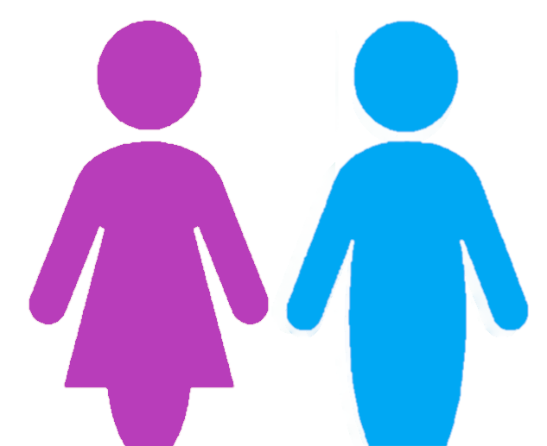
Gender Pay Gap Report
Our colleagues are passionate about creating an exceptional experience for patients, and we are dedicated to delivering the highest standards of quality and safety. We cannot do this without a workforce that is diverse and inclusive.
The gender pay gap shows the difference between the average (mean or median) earnings of men and women. The mean is the average and the median is the middle number when hourly rates are placed in order from lowest to highest; both calculations are expressed as a percentage of male earnings.
Equal pay is not the same as the gender pay gap; it deals with pay discrimination and the differences in pay when members of the opposite sex are paid differently but yet they carry out the same work, similar work or work of equal value. We are committed to supporting equality through fair pay and we strive to ensure that men and women are paid equally for doing equal work.
PROPORTION OF WORKFORCE
PROPORTION RECEIVING A BONUS
66%
34%
4.5%
4.9%

Slide 3
Gender Pay Gap Report
Type |  | Non Doctors | Doctors | Combined
Mean gender pay gap |  | 1.7% | -0.6% | 28.1%
Median gender pay gap |  | 2.7% | -2.0% | 10.6%

Slide 4
Gender Pay Gap Report
Type |  | Non Doctors | Doctors | Combined
Mean bonus gender pay gap |  | 39.9% | -260.50% | 28.7%
Median bonus gender pay gap |  | 42.9% | -226.8% | 42.1%

Slide 5

Gender Pay Gap Report
PAY QUARTILES
Hourly Rate Range: £11.40 to £13.29
Salary Range: £22230 to £25915.50
Hourly Rate Range: £13.29 to £15.35
Salary Range: £25915.50 to £29932.50
Hourly Rate Range: £15.36 to £28.19
Salary Range: £29952 to £54970.50
Hourly Rate Range: £28.21
Salary Range: £55009.50
WHAT DO OUR RESULTS SHOW?
The mean gender pay gap has increased slightly from 2023, the proportion of males and females has remained the same suggesting this likely a result of changes in proportion between the quartiles. Within the Lower quartiles the number of males has reduced slightly, however in the Upper quartiles the proportion of males has increased with the largest increase being in the Upper quartile. The proportion of employees receiving bonus’s has significantly reduced from last year, the mean bonus gender pay gap has reduced and there is only a small difference in the percentage of males and females receiving bonus’s. Whilst the average bonus gender pay gap has reduced, the median bonus gap has increased indicating that the value of male bonus’s has increased.
CLOSING THE GAP
We are committed to maintaining a diverse and gender balanced workforce and we will continue to promote and celebrate diversity and inclusion within the business and the wider community.
We will continue to support women in the business through the offering of women in leadership programmes.
We support any action designed to highlight the gaps in pay regardless of how these occur. We will work to ensure that all individuals are given equal opportunity to progress within the business in terms of both pay and progression, regardless of gender.

