Slide 1
Gender Pay Gap Report
Practice Plus Group Health and Rehabilitation Services Limited
2024

Slide 2
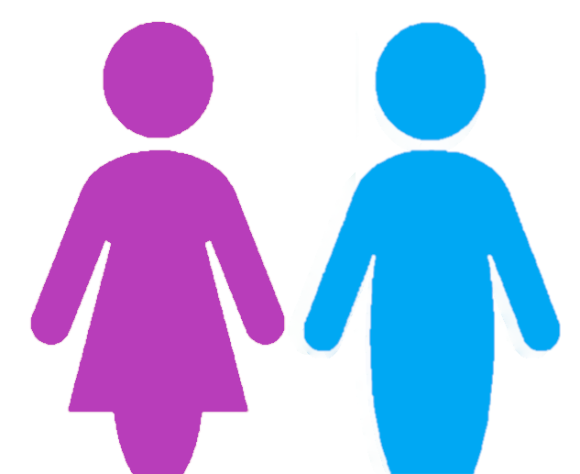
Gender Pay Gap Report
Our colleagues are passionate about creating an exceptional experience for patients, and we are dedicated to delivering the highest standards of quality and safety. We cannot do this without a workforce that is diverse and inclusive.
The gender pay gap shows the difference between the average (mean or median) earnings of men and women. The mean is the average and the median is the middle number when hourly rates are placed in order from lowest to highest; both calculations are expressed as a percentage of male earnings.
Equal pay is not the same as the gender pay gap; it deals with pay discrimination and the differences in pay when members of the opposite sex are paid differently but yet they carry out the same work, similar work or work of equal value. We are committed to supporting equality through fair pay and we strive to ensure that men and women are paid equally for doing equal work.
PROPORTION OF WORKFORCE
PROPORTION RECEIVING A BONUS
81%
19%
3.9%
4.8%

Slide 3
Gender Pay Gap Report
Type |  | Non Doctors | Doctors | Combined
Mean gender pay gap |  | 14.5% | 1.1% | 24.8%
Median gender pay gap |  | 14.6% | 4% | 16.8%

Slide 4
Gender Pay Gap Report
Type |  | Non Doctors | Doctors | Combined
Mean bonus gender pay gap |  | 52.8% | -85.2% | 50.7%
Median bonus gender pay gap |  | 22.1% | -85.2% | 21.9%

Slide 5
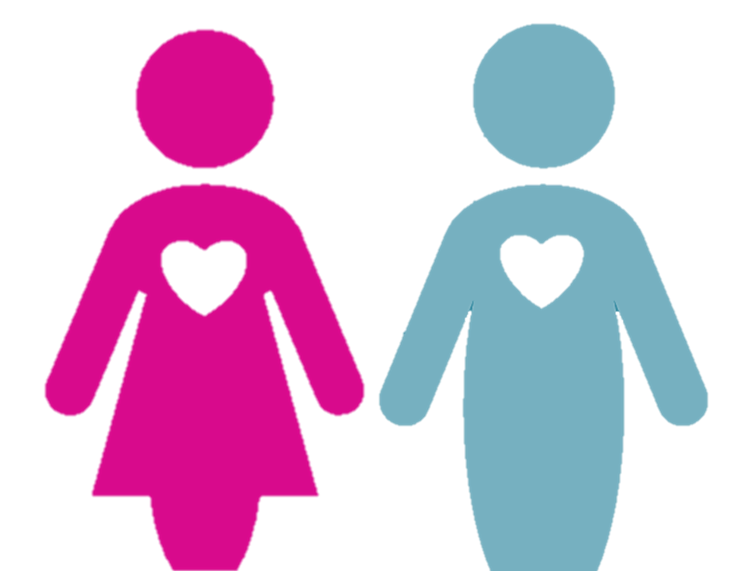
Gender Pay Gap Report
PAY QUARTILES
Hourly Rate Range: £11.40 to £14.52
Salary Range: £22230 to £28314
Hourly Rate Range: £14.52 to £19.42
Salary Range: £28314 to £37869
Hourly Rate Range: £19.42 to £25.41
Salary Range: £37869 to £49549.50
Hourly Rate Range: £25.42
Salary Range: £49569
WHAT DO OUR RESULTS SHOW?
The mean gender pay gap has reduced by 2.7% since last year with the median remaining almost the same (0.2% increase). The proportion of men and woman has remained very stable with only a slight change in the middle quartiles, overall the proportion of males increased by 1%. The Lower Middle and Upper quartiles have a negative Gender Pay Gap and Median Gender Pay Gap with the largest gap now being in the lower quartile. In previous year there were no medical bonus’s for males, this year there were but the female bonus’s were significantly higher resulting in a significantly negative mean and median gender pay gap for doctors. Overall the proportion of people receiving a bonus has decreased but more so for males the gap between proportion of those receiving a bonus has fallen from 2.1% to 0.9%. However the overall bonus mean and median gender pay gap has risen due to mean amount for male bonus’s being 50% higher than for females. As with previous year the largest proportion of males is in the Upper quartile where high bonus’s are applicable explaining the large bonus gap.
CLOSING THE GAP
We are committed to maintaining a diverse and gender balanced workforce and we will continue to promote and celebrate diversity and inclusion within the business and the wider community.
We will continue to support women in the business through the offering of women in leadership programmes.
We support any action designed to highlight the gaps in pay regardless of how these occur. We will work to ensure that all individuals are given equal opportunity to progress within the business in terms of both pay and progression, regardless of gender.

